Slide 1
Representation of “Meaning” in Text
Manish Shrivastava

Slide 2
Outline
Why do we need vector representations?
Word2Vec
GloVe
RNN/LSTM
Contextual Embeddings
ELMo
BERT

Slide 3
NLP Tasks
Kinds of Tasks
Classification
Sentiment, Topic, Origin etc.
Regression
Likelihood of Belonging ( Language Modeling)
Clustering
Semantic Search, Recommendation, Topic Modeling
Sequence Labeling
POS Tagging, Named Entity Recognition, Chunking etc.

Slide 4
Vectors in NLP
Number of Applications
Primary premise:
Word Representation : Words represented as dense vectors embedded in a vector space
Many different approaches to learn
Many different applications
Some new ones : Word Analogies, Semantic Similarity etc.

Slide 5
Role of Deep Learning in NLP
Similarity?
France:Paris::Russia:Moscow
E(King)-E(Man)+E(Woman) =E(Queen)

Slide 6
Role of Deep Learning in NLP
Similarity?
Not Really!!
Methods for Semantic Similarity have existed for a long time.
Distributional Semantics

Slide 7
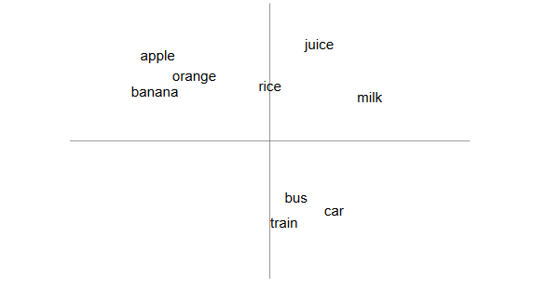
“You shall know a word by the company it keeps!”
Firth (1957)

Slide 8
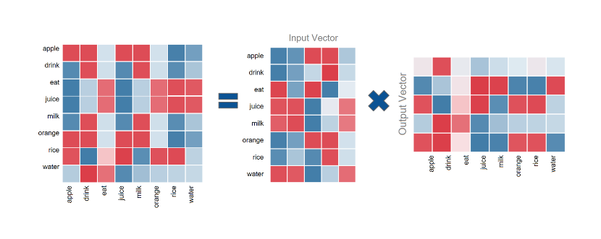
Singular Value Decomposition
The problem with this method, is that we may end up with matrices having billions of rows and columns, which makes SVD computationally restrictive.

Slide 9
Singular Value Decomposition (SVD)
Handy mathematical technique that has application to many problems
Given any m×n matrix A, algorithm to find matrices U, V, and W such that
A = U W V^{T}
U is m×n and orthonormal
W is n×n and diagonal
V is n×n and orthonormal

Slide 10
SVD
Treat as black box: code widely available

Slide 11
SVD
The w_{i} are called the singular values of A
If A is singular, some of the w_{i} will be 0
In general rank(A) = number of nonzero w_{i}
SVD is mostly unique (up to permutation of singular values, or if some w_{i} are equal)

Slide 12
Applications of Word Vectors
Word Similarity
Easily identifies similar words and synonyms since they occur in similar contexts
Stemming (thought -> think)
Inflections, Tense forms
eg. Think, thought, ponder, pondering,
eg. Plane, Aircraft, Flight

Slide 13
Applications of Word Vectors
2. Machine Translation
I am a cook .
நான் ஒரு சமையல்காரன்.
मैं एक बावर्ची हूं ।
Je suis un cuisinier .

Slide 14
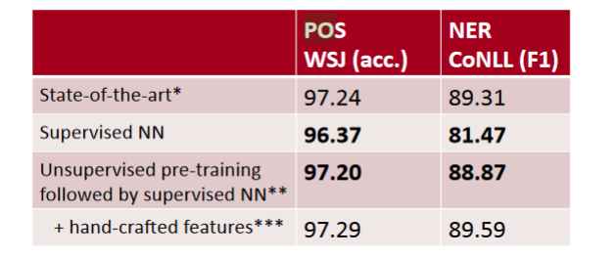
Applications of Word Vectors
Part-of-Speech and Named Entity Recognition

Slide 15
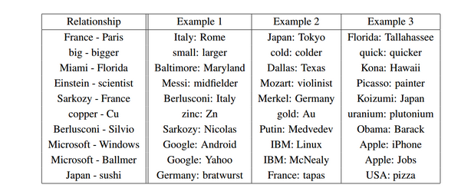
Applications of Word Vectors
4. Relation Extraction

Slide 16
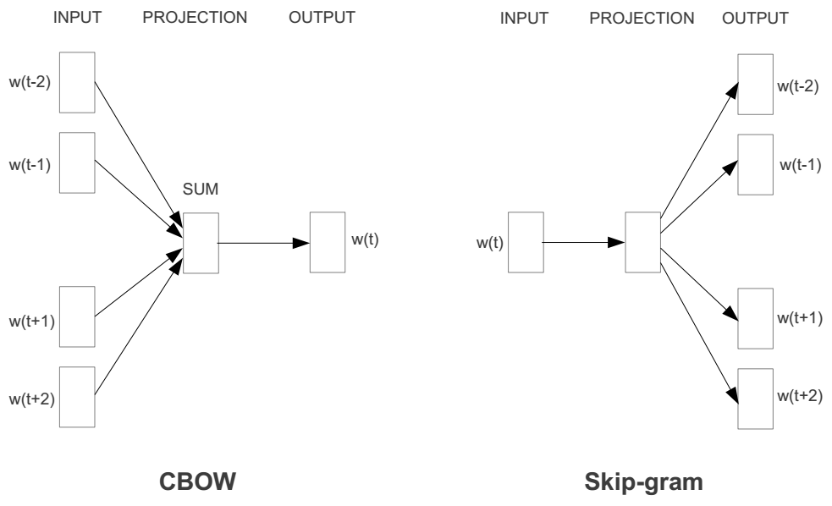
Represent the meaning of word Word2vec
2 basic neural network models:
Continuous Bag of Word (CBOW): use a window of word to predict the middle word
Skip-gram (SG): use a word to predict the surrounding ones in window.

Slide 17
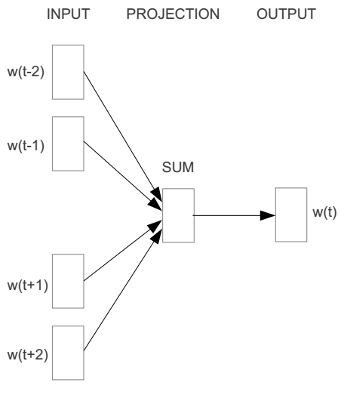
Word2vec – Continuous Bag of Word
E.g. “The cat sat on floor”
Window size = 2
the
cat
sat
on
floor

Slide 18
Input layer
Index of cat in vocabulary
0
1
0
cat
0
Hidden layer
Output layer
0
0
0
0
0
0
…
0
0
0
one-hot
vector
0
sat
one-hot
vector
0
0
0
0
1
0
…
1
0
on
0
0
0
0
…
0

Slide 19
We must learn W and W’
Input layer
0
1
0
cat
0
$$W_{V×N}$$
Hidden layer
Output layer
0
0
0
0
0
0
V-dim
…
0
0
$${W′}_{N×V}$$
0
0
sat
0
0
0
0
1
0
$$W_{V×N}$$
N-dim
…
V-dim
1
0
on
0
0
0
0
V-dim
…
N will be the size of word vector
0

Slide 20
$$W_{V×N}^{T} ×x_{cat}=v_{cat}$$
0.1 | 2.4 | 1.6 | 1.8 | 0.5 | 0.9 | … | … | … | 3.2
0.5 | 2.6 | 1.4 | 2.9 | 1.5 | 3.6 | … | … | … | 6.1
… | … | … | … | … | … | … | … | … | …
… | … | … | … | … | … | … | … | … | …
0.6 | 1.8 | 2.7 | 1.9 | 2.4 | 2.0 | … | … | … | 1.2
0
2.4
2.6
…
…
1.8
Input layer
1
$$×$$
0
$$=$$
0
0
1
0
0
0
x_{cat}
0
0
Output layer
0
0
0
$$W_{V×N}^{T}×x_{cat}=v_{cat}$$
…
0
0
0
0
0
V-dim
…
0
0
$$\hat{v}=\frac{v_{cat}+v_{on}}{2}$$
0
+
0
sat
0
0
0
0
$$W_{V×N}^{T}×x_{on}=v_{on}$$
1
0
…
V-dim
1
Hidden layer
0
x_{on}
0
0
N-dim
0
0
V-dim
…
0

Slide 21
$$W_{V×N}^{T} ×x_{on}=v_{on}$$
0.1 | 2.4 | 1.6 | 1.8 | 0.5 | 0.9 | … | … | … | 3.2
0.5 | 2.6 | 1.4 | 2.9 | 1.5 | 3.6 | … | … | … | 6.1
… | … | … | … | … | … | … | … | … | …
… | … | … | … | … | … | … | … | … | …
0.6 | 1.8 | 2.7 | 1.9 | 2.4 | 2.0 | … | … | … | 1.2
0
1.8
2.9
…
…
1.9
Input layer
0
$$×$$
0
$$=$$
0
1
1
0
0
0
x_{cat}
0
0
Output layer
0
0
0
$$W_{V×N}^{T}×x_{cat}=v_{cat}$$
…
0
0
0
0
0
V-dim
…
0
0
$$\hat{v}=\frac{v_{cat}+v_{on}}{2}$$
0
+
0
sat
0
0
0
0
$$W_{V×N}^{T}×x_{on}=v_{on}$$
1
0
…
V-dim
1
Hidden layer
0
x_{on}
0
0
N-dim
0
0
V-dim
…
0

Slide 22
Input layer
0
1
0
cat
0
$$W_{V×N}$$
Hidden layer
Output layer
0
0
0
0
0
0
V-dim
…
0
0
$$W_{V×N}^{′}×\hat{v}=z$$
0
$$\hat{y}=softmax(z)$$
0
0
0
0
0
$$\hat{v}$$
1
0
$$W_{V×N}$$
…
1
N-dim
0
on
0
${\hat{y}}_{sat}$
0
0
V-dim
0
V-dim
…
N will be the size of word vector
0

Slide 23
Input layer
0
We would prefer $\hat{y}$ close to ${\hat{y}}_{sat}$
1
0
cat
0
$$W_{V×N}$$
Hidden layer
Output layer
0
0
0
0
0.01
0.02
0.00
0.02
0.01
0.02
0.01
0.7
…
0.00
0
0
V-dim
…
0
0
$$W_{V×N}^{′}×\hat{v}=z$$
$$\hat{y}=softmax(z)$$
0
0
0
0
0
0
$$\hat{v}$$
1
0
$$W_{V×N}$$
…
1
N-dim
0
on
0
${\hat{y}}_{sat}$
0
0
V-dim
0
V-dim
…
N will be the size of word vector
$\hat{y}$
0

Slide 24
$$W_{V×N}^{T}$$
0.1 | 2.4 | 1.6 | 1.8 | 0.5 | 0.9 | … | … | … | 3.2
0.5 | 2.6 | 1.4 | 2.9 | 1.5 | 3.6 | … | … | … | 6.1
… | … | … | … | … | … | … | … | … | …
… | … | … | … | … | … | … | … | … | …
0.6 | 1.8 | 2.7 | 1.9 | 2.4 | 2.0 | … | … | … | 1.2
Contain word’s vectors
Input layer
0
1
0
x_{cat}
0
Output layer
0
0
$$W_{V×N}^{}$$
0
0
0
0
V-dim
…
0
0
$$W_{V×N}^{′}$$
0
0
sat
0
0
0
0
1
0
$$W_{V×N}^{}$$
…
1
0
V-dim
x_{on}
0
Hidden layer
0
N-dim
0
0
V-dim
…
0
We can consider either W or W’ as the word’s representation. Or even take the average.
Notes:
W contains input word vectors.
W’ contains output word vectors.
We can consider either W or W’ as the word’s representation. Or even take the average.

Slide 25
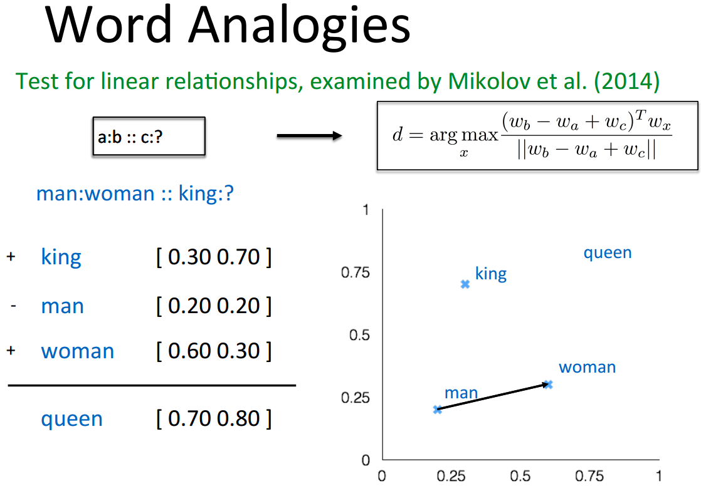
Some interesting results

Slide 26
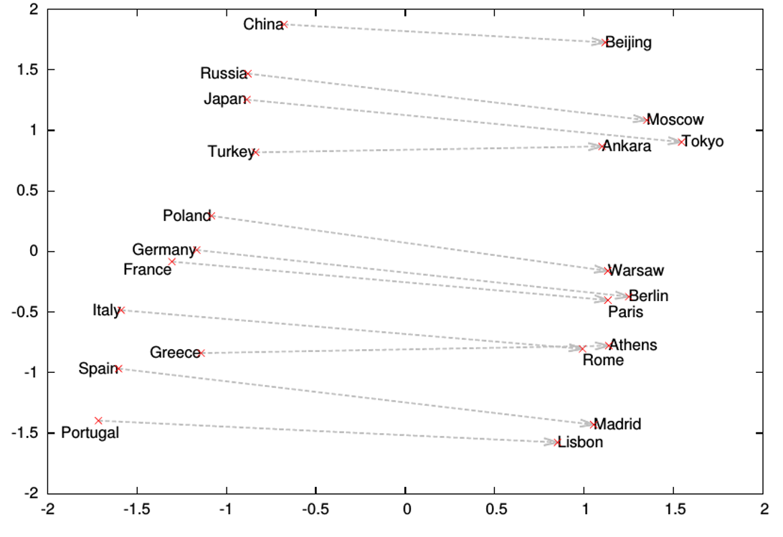
Word analogies

Slide 27



Encoding meaning in vector differences [Pennington, Socher, and Manning, EMNLP 2014]
Crucial insight:
Ratios of co-occurrence probabilities can encode meaning components
x = solid
x = gas
x = water
x = random
large
small
large
small
small
large
large
small
large
small
~1
~1

Slide 28
Encoding meaning in vector differences [Pennington et al., EMNLP 2014]
Crucial insight:
Ratios of co-occurrence probabilities can encode meaning components
x = solid
x = gas
x = water
x = fashion
1.9 x 10⁻⁴
6.6 x 10⁻⁵
3.0 x 10⁻³
1.7 x 10⁻⁵
2.2 x 10⁻⁵
7.8 x 10⁻⁴
2.2 x 10⁻³
1.8 x 10⁻⁵
8.9
8.5 x 10⁻²
1.36
0.96

Slide 29
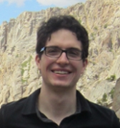


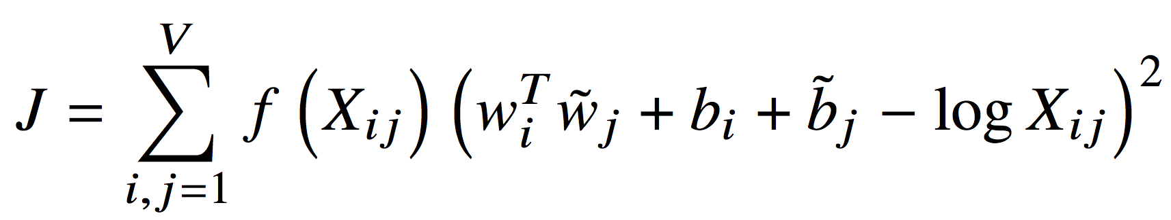
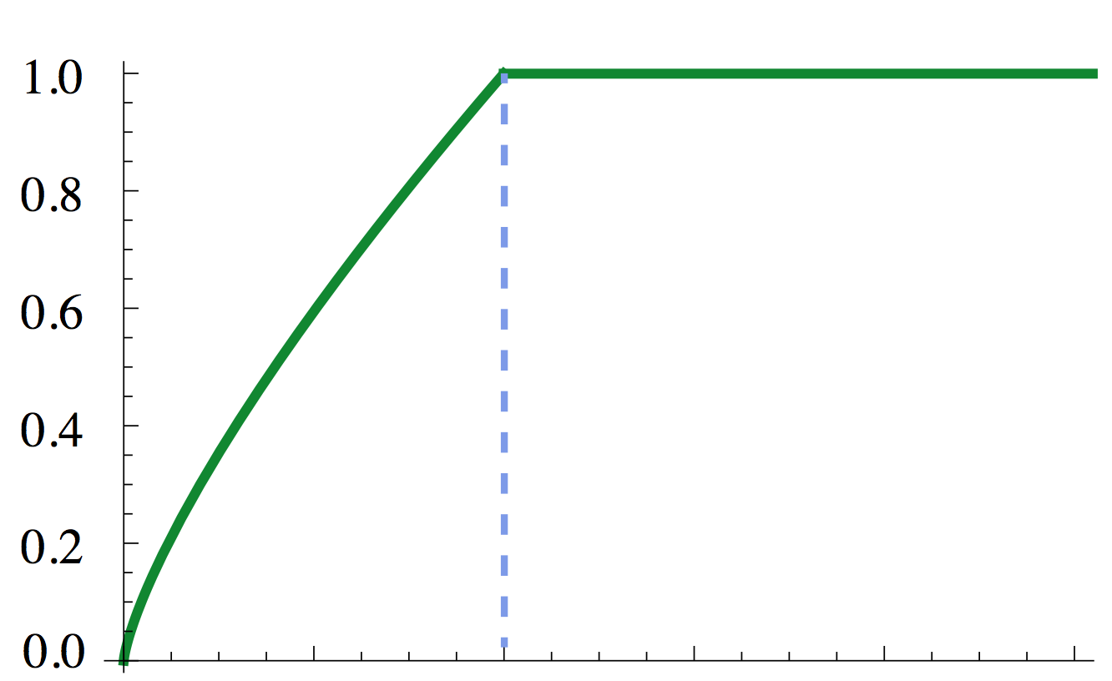
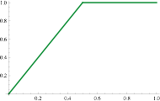

GloVe: A new model for learning word representations [Pennington et al., EMNLP 2014]
Notes:
Q: How can we capture this in a word vector space?
A: Log-bilinear model
Fast training
Scalable to huge corpora
Good performance even with small corpus, and small vectors

Slide 30
Named Entity Recognition Performance
Model on CoNLL | CoNLL 2003 dev | CoNLL 2003 test | ACE 2 | MUC 7
Categorical CRF | 91.0 | 85.4 | 77.4 | 73.4
SVD (log tf) | 90.5 | 84.8 | 73.6 | 71.5
HPCA | 92.6 | 88.7 | 81.7 | 80.7
HSMN (Huang) | 90.5 | 85.7 | 78.7 | 74.7
C&W | 92.2 | 87.4 | 81.7 | 80.2
CBOW | 93.1 | 88.2 | 82.2 | 81.1
GloVe (this work) | 93.2 | 88.3 | 82.9 | 82.2
F1 score of CRF trained on CoNLL 2003 English with 50 dim word vectors.

Slide 31
The GloVe Model
A new global-statistics, unsupervised model for learning word vectors
Design translates relationships between word-word co-occurrence probabilities that encode meaning relationships into linear relations in a word vector space
http://nlp.stanford.edu/projects/glove/

Slide 32
Now what?
Word2Vec == Deep Learning
No!
The first step
Embeddings are dense vectors
Can encapsulate context information
Can serve as information points similar to pixels
Serve as input to Deep learning models
CNNs, RNNs and many more

Slide 33

Language Modelling Problem
Aim is to calculate the probability of a sequence (sentence) P(X)
Can be decomposed into product of conditional probabilities of tokens (works):
In practice, only finite content used

Slide 34

N-Gram Language Model
N-Grams estimate word conditional probabilities via counting:
Sparse (alleviated by back-off, but not entirely)
Doesn’t exploit word similarity
Finite Context

Slide 35
Neural Network Language Models (NNLMs)
Feed-forward NNLM
Recurrent NNLM
Output
Output
Output
aardvark = 0.000041
aardvark = 0.000054
aardvark = 0.0082
…
…
…
drove = 0.045
to = 0.267
store = 0.0191
…
…
…
zygote = 0.00003
zygote = 0.000009
zygote = 0.003
Hidden 2
Recurrent Hidden
Recurrent Hidden
Hidden 1
Embedding
Embedding
Embedding
Embedding
Embedding
Embedding
he
drove
he
drove
to
the

Slide 36
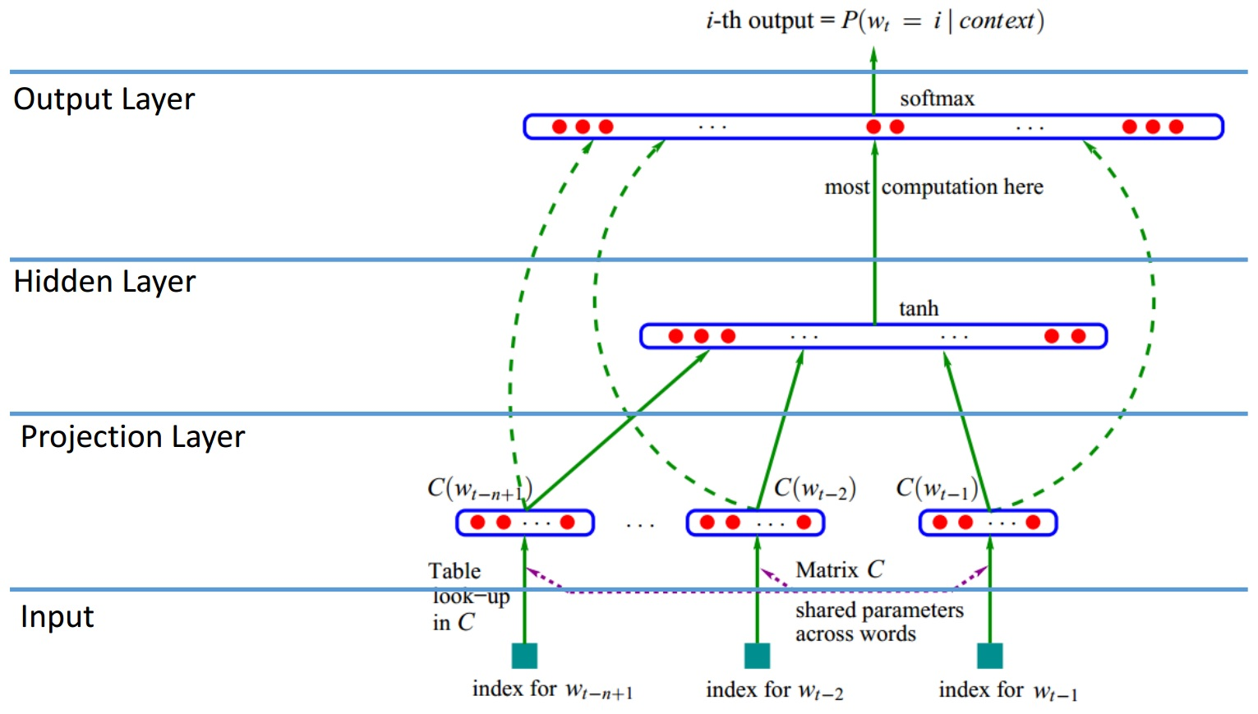
Neural Network Language Model
Y. Bengio et al., JMLR’03

Slide 37
Limitation of Neural Network Language Model
Sparsity – Solved
World Similarity – Solved
Finite Context – Not
Computational Complexity - Softmax

Slide 38
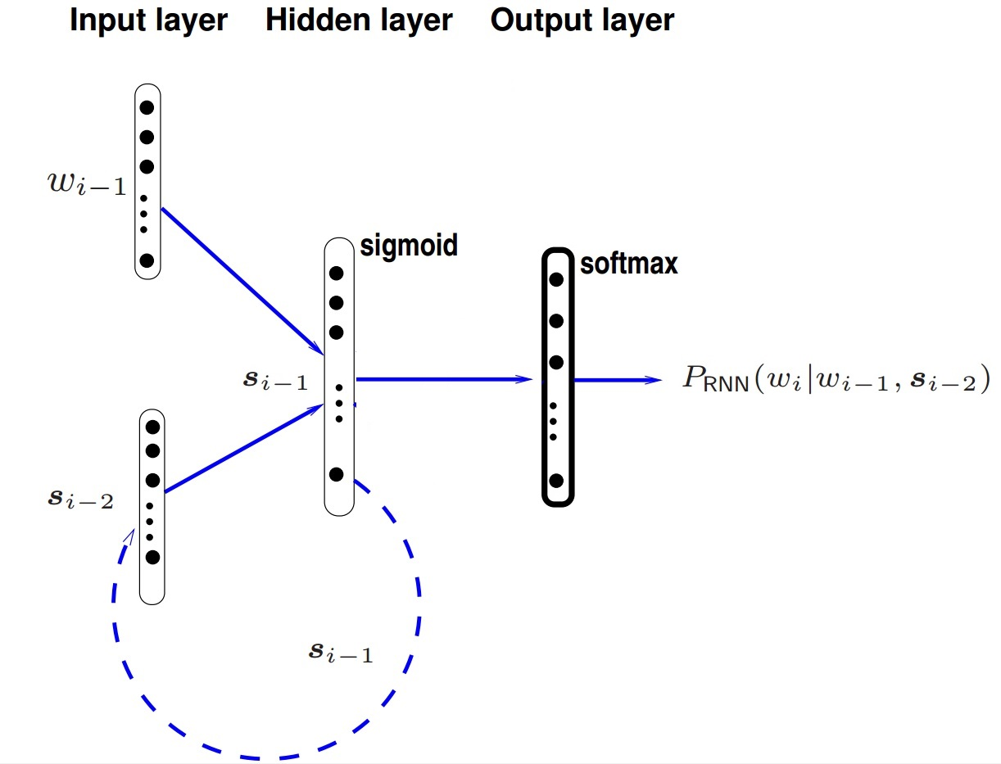
Recurrent Neural Network Language Model
[X. Liu, et al.]

Slide 39
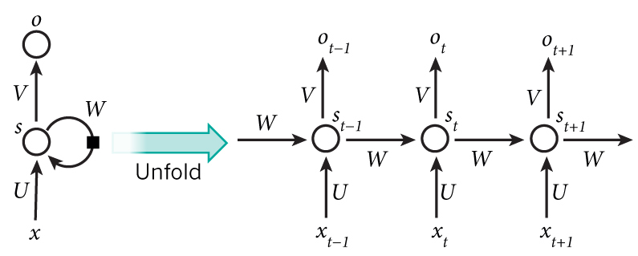
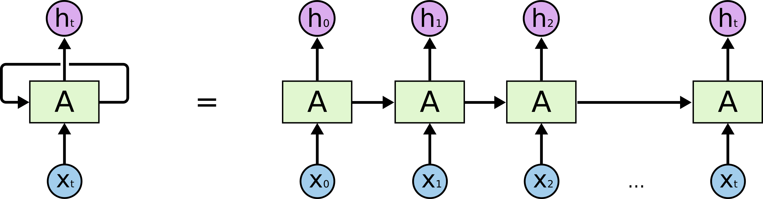
Recurrent Neural Network

Slide 40
How does RNN reduce complexity?
Given function f: h’,y=f(h,x)
h and h’ are vectors with the same dimension
y¹
y²
y³
h⁰
f
h¹
f
h²
f
h³
……
x¹
x²
x³
No matter how long the input/output sequence is, we only need one function f. If f’s are different, then it becomes a feedforward NN. This may be treated as another compression from fully connected network.

Slide 41

Deep RNN
h’,y = f₁(h,x), g’,z = f₂(g,y)
…
…
…
z¹
z²
z³
g⁰
f₂
g¹
f₂
g²
f₂
g³
……
y¹
y²
y³
h⁰
f₁
h¹
f₁
h²
f₁
h³
……
x¹
x²
x³

Slide 42
Bidirectional RNN
y,h=f₁(x,h)
z,g = f₂(g,x)
x¹
x²
x³
g⁰
f₂
g¹
f₂
g²
f₂
g³
z¹
z²
z³
p¹
p²
p³
p=f₃(y,z)
f₃
f₃
f₃
y¹
y²
y³
h⁰
f₁
h¹
f₁
h²
f₁
h³
x¹
x²
x³

Slide 43
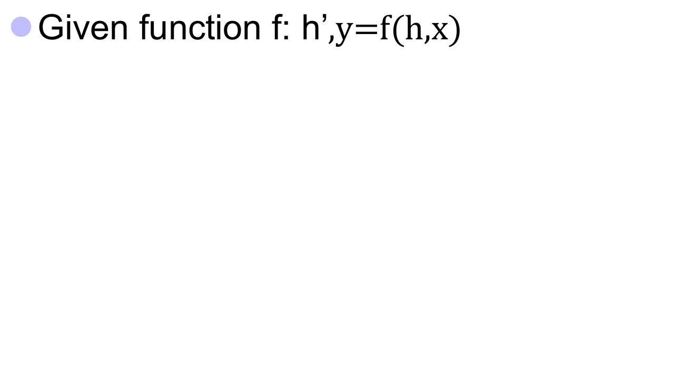



Naïve RNN
y
h'
W^{h}
^{h}
W^{i}
x
h
f
h'
y
Wº
^{h’}
Note, y is computed
from h’
x
softmax
We have ignored the bias

Slide 44
Limitation of RNN Language Model
Sparsity – Solved!
World Similarity -> Sentence Similarity – Solved!
Finite Context – Solved? Not quite…
Still Computationally Complex Softmax

Slide 45
Problems with naive RNN
When dealing with a time series, it tends to forget old information. When there is a distant relationship of unknown length, we wish to have a “memory” to it.
Vanishing gradient problem.

Slide 46
RNN has been a natural choice
In many NLP tasks
In time series data (stock prices, web logs, weather etc.)
Fill in the blanks or predict what happens next in time
Sequence to sequence (translation, speech recognition etc.)
Sometimes for classifying a sequence (sentiment analysis)

Slide 47


RNN basic architecture
o
Training through back propagation
o
o
o
t-1
t
t+1
V
V
V
V
W
h
h
h
h
t-1
t
t+1
W
W
W
W
U
U
U
U
x
x
x
t-1
t
t+1

Slide 48
RNN basic architecture
- input at time step t
- hidden state at time step t (memory of the network)
- output at time step t
U,V,W are parameters (shared across all layers)
x
t
h
t
o
t

Slide 49
RNN basic architecture
o
0.5 0.4
0.4 0.6
0.4 0.5
0.3 0.5
x =
0.4
0.2
h =
0.3
0.8
t
U =
W =
t
t-1
V
h
h
x
h
U
W
t-1
t
t
t-1
W
h
=
0.5 0.4
0.4 0.6
0.4
0.2
+
0.4 0.5
0.3 0.5
0.3
0.8
U
tanh
t
x
t
.28
.28
.52
.29
.88
.77
.66
.64
h
=
+
=
=
tanh
tanh
t

Slide 50

RNN basic architecture
o
0.5 0.4
0.4 0.6
0.4 0.5
0.3 0.5
x =
0.4
0.2
h =
0.3
0.8
t
U =
W =
t
t-1
V
h
h
h
.66
.64
0.4 0.7
0.3 0.1
=
V =
t-1
t
t
W
U
o
=
0.4 0.7
0.3 0.1
.66
.64
=
.61
.39
softmax
t
x
V
h
t
t

Slide 51
RNN basic architecture
o
o
0.5 0.4
0.4 0.6
0.4 0.5
0.3 0.5
x =
0.5
0.4
.66
.64
U =
W =
h =
t
t+1
t+1
t
V
V
h
h
h
t-1
t
t+1
W
W
W
U
x
W
h
t+1
t
U
U
0.5
0.4
0.4 0.5
0.3 0.5
.66
.64
h
=
tanh
0.5 0.4
0.4 0.6
+
x
x
t+1
t
t+1

Slide 52
Lets design some Recurrent networks
o
Sentiment Classification
n
h
h
h
….
….
h
1
2
n-1
0
x
x
….
x
x
1
2
n-1
n
Movie
was
and
boring

Slide 53
Lets design some Recurrent networks
A
C
H
I
N
…
M
A
C
H
I
N

Slide 54
Lets design some Recurrent networks
bienvenue
à
la
conférence
Fails to handle long term dependencies
NULL
bienvenue
à
la
welcome
to
the
lecture

Slide 55
Longer dependencies required
The clouds are in the ____
I grew up in France. In a small beautiful town… I speak fluent _____

Slide 56
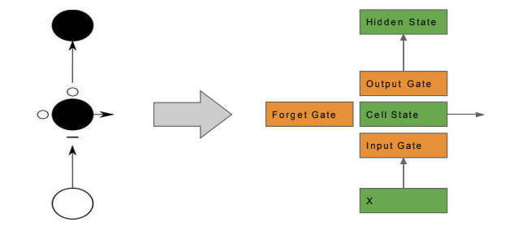
LSTM’s

Slide 57
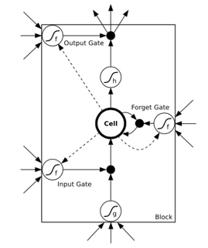
LSTM’s

Slide 58
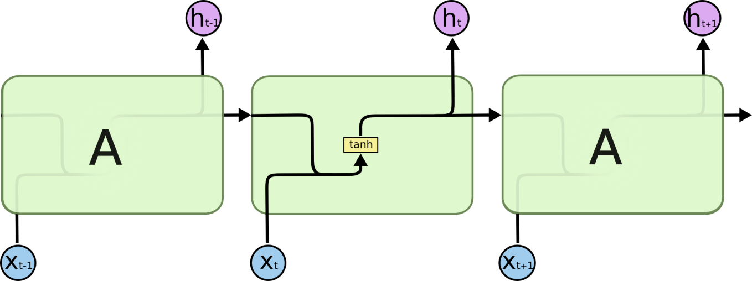
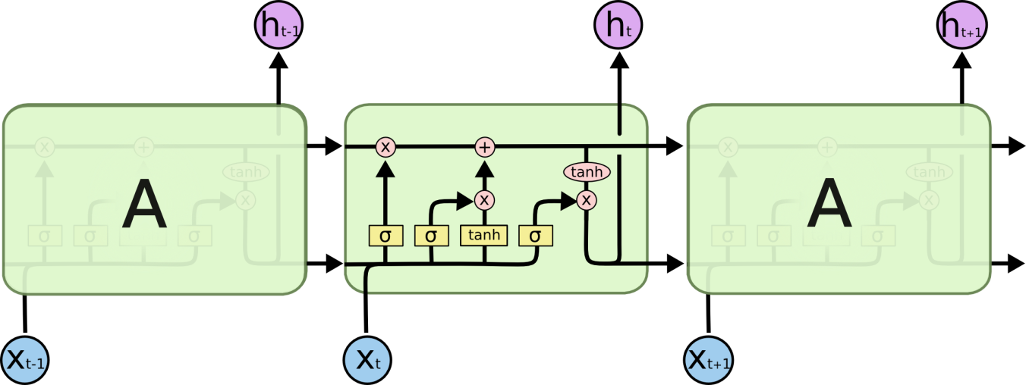
RNN vs LSTM’s
http://colah.github.io/posts/2015-08-Understanding-LSTMs/

Slide 59
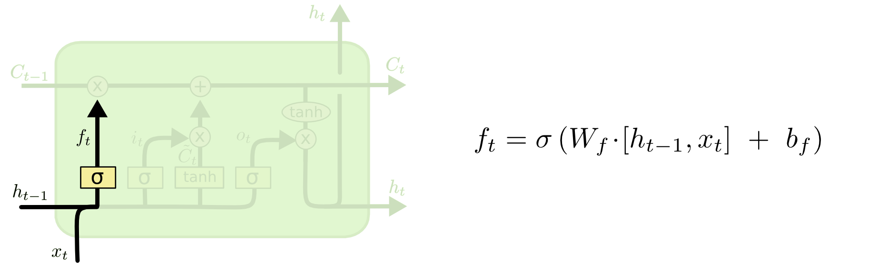
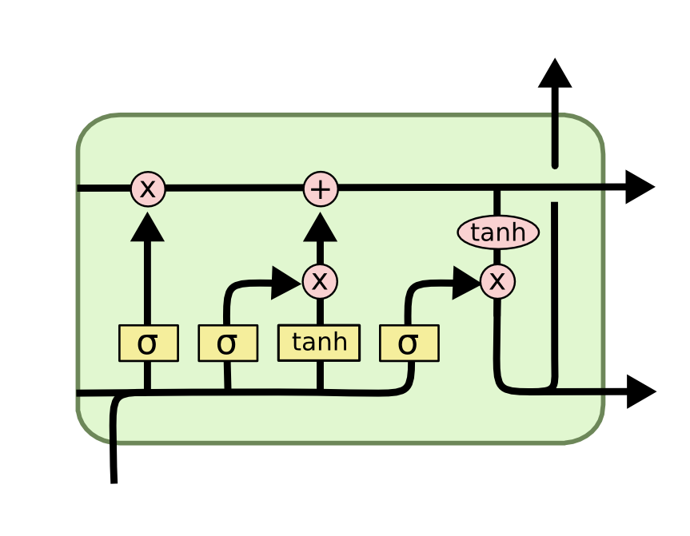
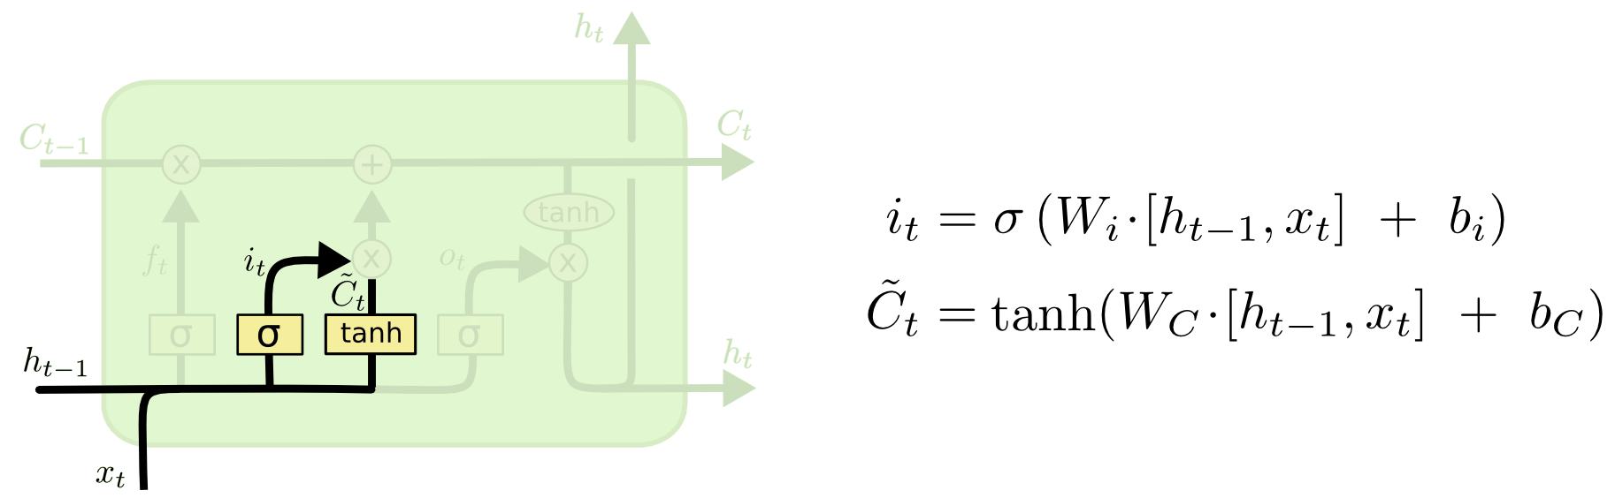
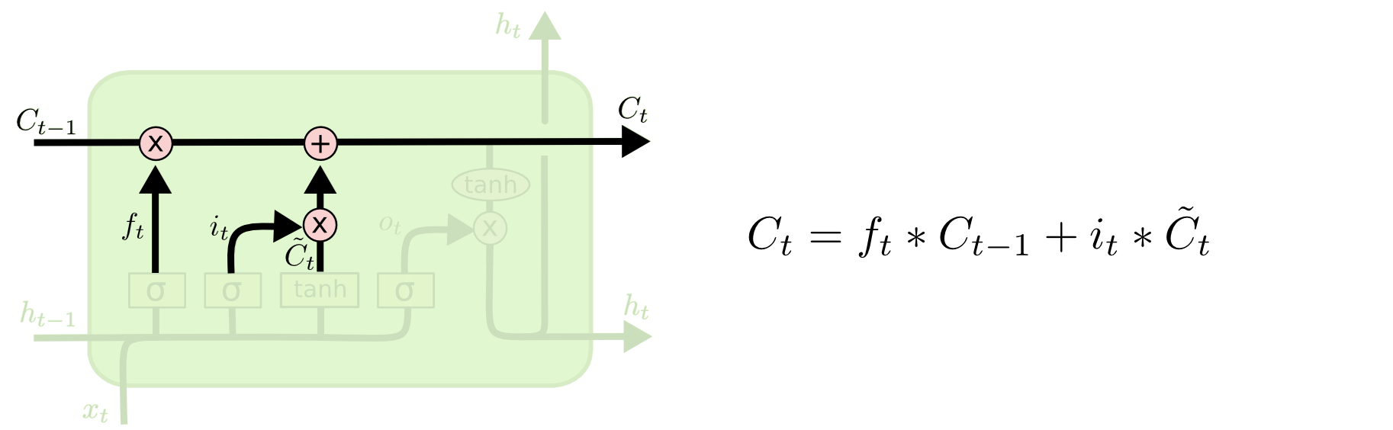
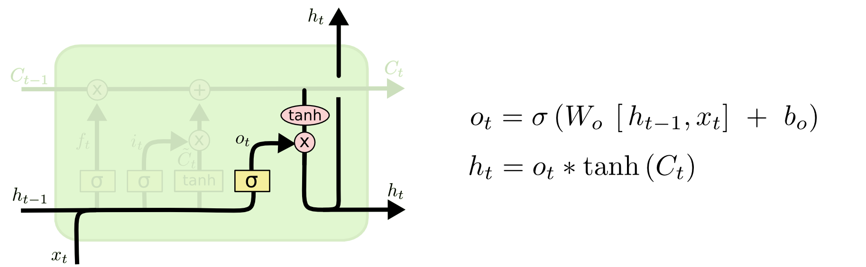
i_{t} decides what component
is to be updated.
C’_{t} provides change contents
Updating the cell state
Decide what part of the cell
state to output

Slide 60
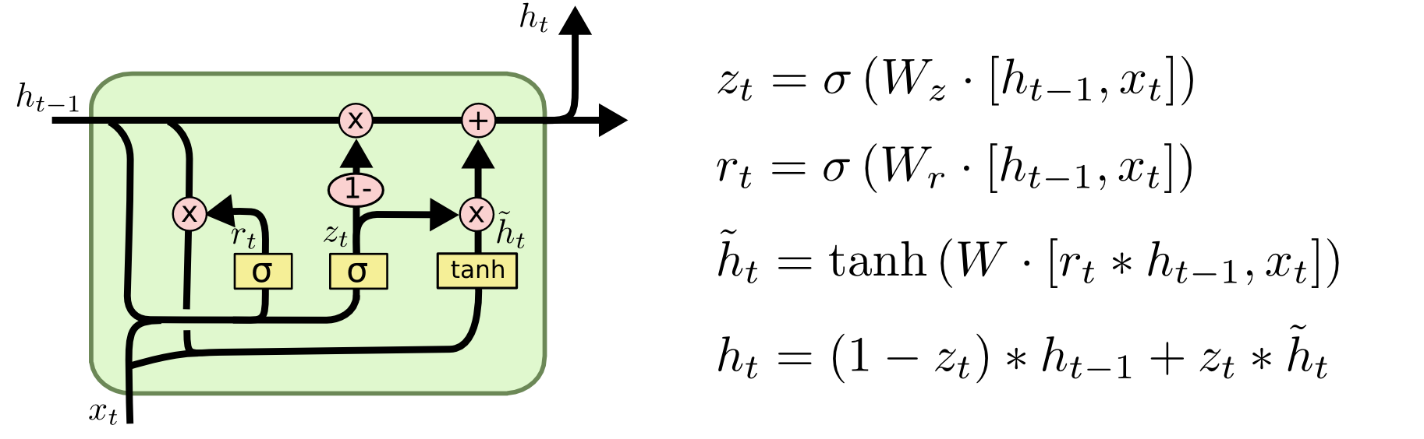
LSTM’s
Key take away: LSTMs are essentially the same thing as the RNN, they just have a different way of computing the hidden state.
http://colah.github.io/posts/2015-08-Understanding-LSTMs/

Slide 61
Naïve RNN vs LSTM
y^{t}
LSTM
c^{t}
y^{t}
c^{t-1}
Naïve
RNN
h^{t}
h^{t}
h^{t-1}
h^{t-1}
x^{t}
x^{t}
c changes slowly
c^{t} is c^{t-1} added by something
h changes faster
h^{t} and h^{t-1} can be very different

Slide 62
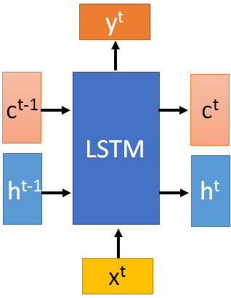

These 4 matrix
computation should
be done concurrently.
x^{t}
z
W
h^{t-1}
c^{t-1}
x^{t}
z^{i}
W^{i}
= σ( )
h^{t-1}
Controls
forget gate
Controls
input gate
Updating
information
Controls
Output gate
W^{f}
x^{t}
z^{f}
= σ( )
h^{t-1}
z^{f}
z^{i}
z
zº
x^{t}
zº
Wº
= σ( )
h^{t-1}
x^{t}
h^{t-1}
Information flow of LSTM

Slide 63
x^{t}
z
W
h^{t-1}
=tanh( )
c^{t-1}
c^{t-1}
diagonal
“peephole”
zº
z^{f}
z^{i}
obtained by the same way
z^{f}
z^{i}
z
zº
h^{t-1}
x^{t}
Information flow of LSTM

Slide 64




Element-wise multiply
y^{t}
c^{t-1}
c^{t}
c^{t} = z^{f}  c^{t-1} + z^{i}z
tanh
h^{t} = zº  tanh(c^{t})
y^{t} = σ(W’ h^{t})
z^{f}
z^{i}
z
zº
h^{t-1}
x^{t}
h^{t}
Information flow of LSTM

Slide 65



LSTM information flow
y^{t}
y^{t+1}
c^{t-1}
c^{t}
c^{t+1}
tanh
tanh
z^{f}
z^{i}
z
zº
z^{f}
z^{i}
z
zº
h^{t+1}
h^{t-1}
x^{t}
h^{t}
x^{t+1}
Information flow of LSTM

Slide 66
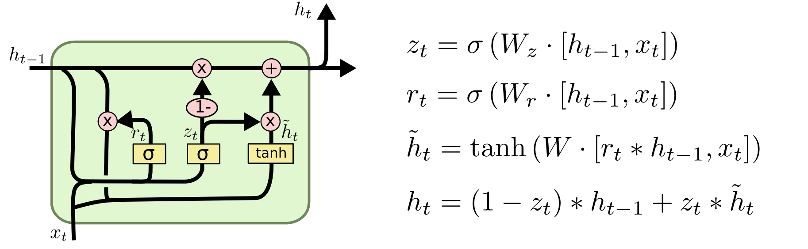
GRU – gated recurrent unit (more compression)
LSTM
reset gate
Update gate
It combines the forget and input into a single update gate.
It also merges the cell state and hidden state. This is simpler
than LSTM. There are many other variants too.
X,*: element-wise multiply

Slide 67
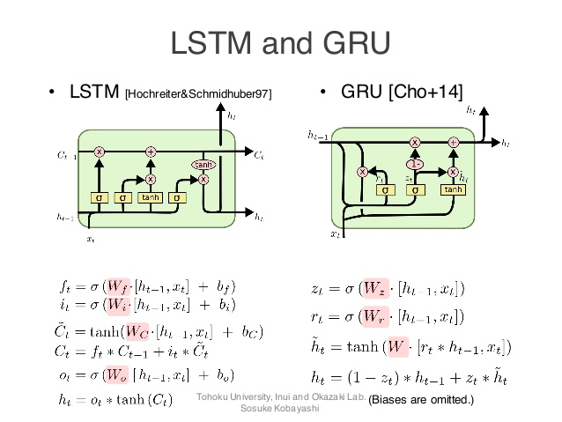
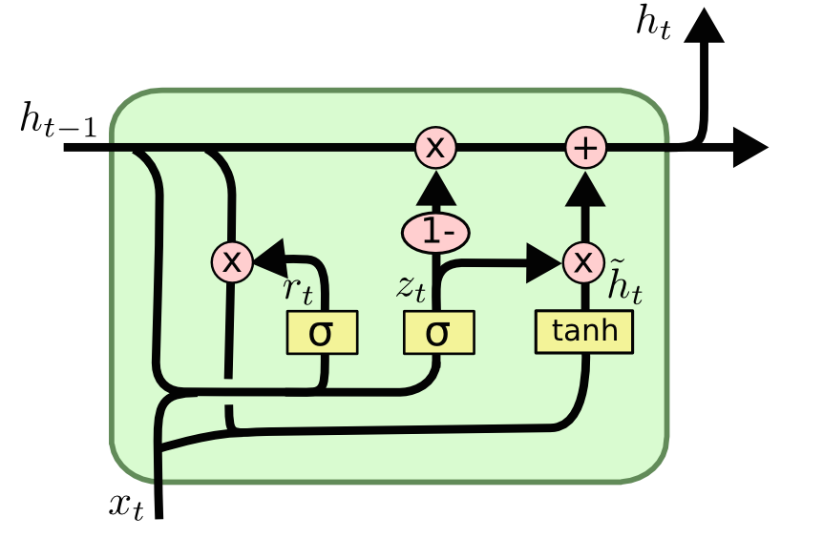
GRUs also takes x_{t} and h_{t-1} as inputs. They perform some calculations and then pass along h_{t}. What makes them different from LSTMs is that GRUs don't need the cell layer to pass values along. The calculations within each iteration insure that the h_{t} values being passed along either retain a high amount of old information or are jump-started with a high amount of new information.

Slide 68
ELMo: Embeddings from Language Models
Pre-trained biLSTM for contextual embedding

Slide 69
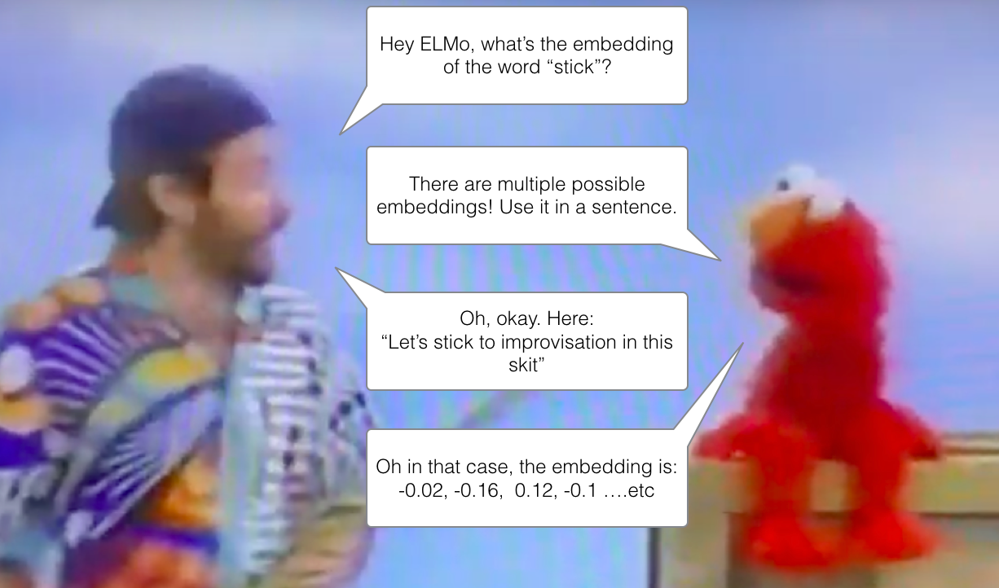
Context-based disambiguation is hard.
Notes:
https://allennlp.org/elmo

Slide 70
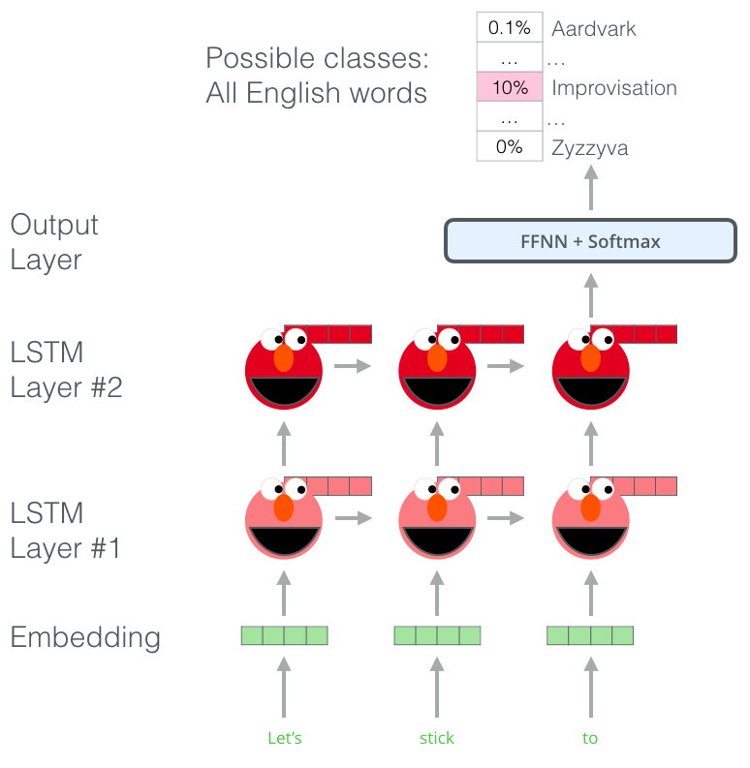
ELMo's biLSTM is pretrained on a language model.
Notes:
https://allennlp.org/elmo http://jalammar.github.io/illustrated-bert/

Slide 71
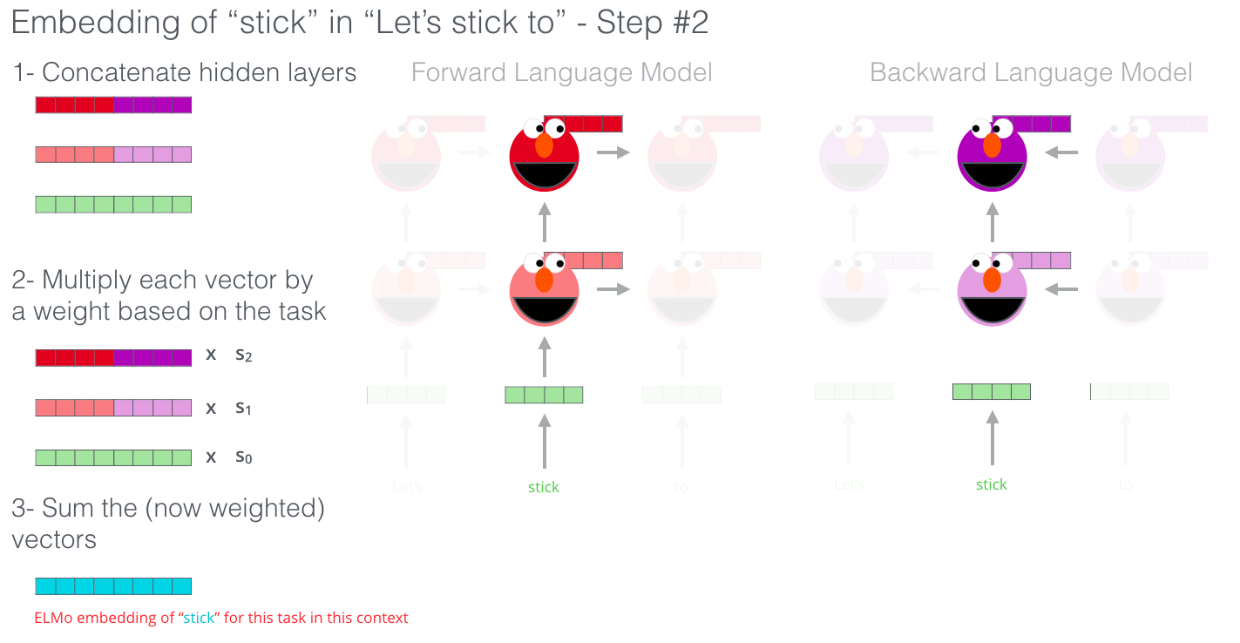
ELMo's embedding of a word given the sentence is the concatenation of its biLSTM's hidden states for the word.
Notes:
https://allennlp.org/elmo

Slide 72
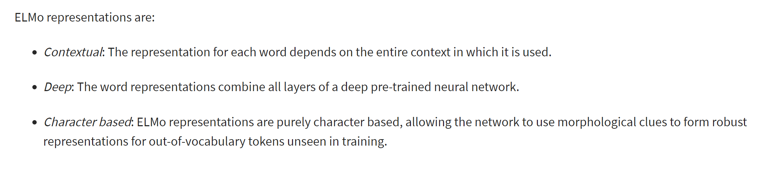
ELMo: biLSTM for neural word embeddings
Notes:
https://allennlp.org/elmo

Slide 73
ELMo on Sentence level tasks

Slide 74
Something else?!
Can we bring more “focus” to individual components of the sentence?
Are individual vectors, contextualized or otherwise, enough?
Shouldn’t we consider interactions of the words with other words

Slide 75
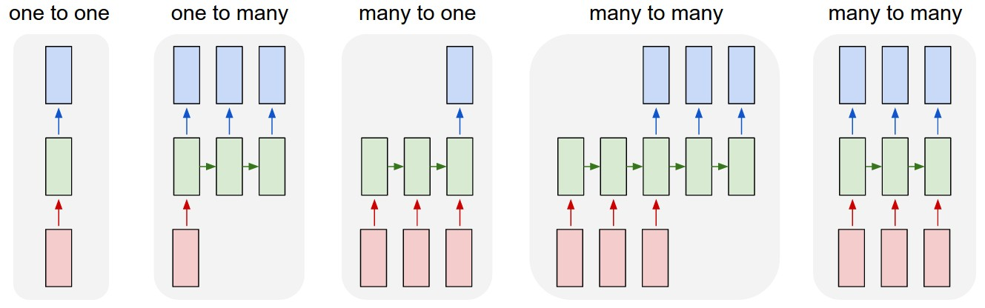
Soft Attention for Translation
“I love coffee” -> “Me gusta el café”
Bahdanau et al, “Neural Machine Translation by Jointly Learning to Align and Translate”, ICLR 2015

Slide 76
Soft Attention for Translation
Distribution over input words
“I love coffee” -> “Me gusta el café”
Bahdanau et al, “Neural Machine Translation by Jointly Learning to Align and Translate”, ICLR 2015

Slide 77
Soft Attention for Translation
Distribution over input words
“I love coffee” -> “Me gusta el café”
Bahdanau et al, “Neural Machine Translation by Jointly Learning to Align and Translate”, ICLR 2015

Slide 78
Soft Attention for Translation
Distribution over input words
“I love coffee” -> “Me gusta el café”
Bahdanau et al, “Neural Machine Translation by Jointly Learning to Align and Translate”, ICLR 2015

Slide 79
Soft Attention for Translation
Distribution over input words
“I love coffee” -> “Me gusta el café”
Bahdanau et al, “Neural Machine Translation by Jointly Learning to Align and Translate”, ICLR 2015

Slide 80
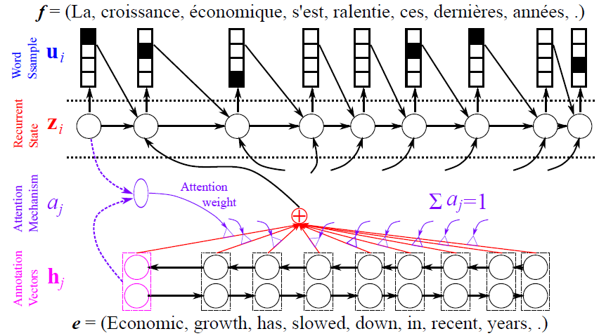
Soft Attention for Translation
From Y. Bengio CVPR 2015 Tutorial

Slide 81
Soft Attention for Translation
Decoder RNN
From Y. Bengio CVPR 2015 Tutorial

Slide 82
Soft Attention for Translation
Decoder RNN
Bidirectional encoder RNN
From Y. Bengio CVPR 2015 Tutorial

Slide 83
Soft Attention for Translation
Decoder RNN
Attention Model
Bidirectional encoder RNN
From Y. Bengio CVPR 2015 Tutorial

Slide 84
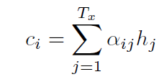


Soft Attention for Translation
Context vector (input to decoder):
Mixture weights:
Alignment score (how well do input words near j match output words at position i):
Bahdanau et al, “Neural Machine Translation by Jointly Learning to Align and Translate”, ICLR 2015

Slide 85
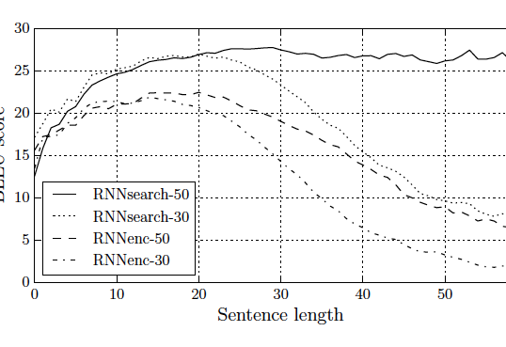
Jointly Learning to Align and Translate
Long sentences
Cho et al. 2014

Slide 86
BERT: Bidirectional Encoder Representations from Transformers
Pre-trained transformer encoder for sentence embedding

Slide 87
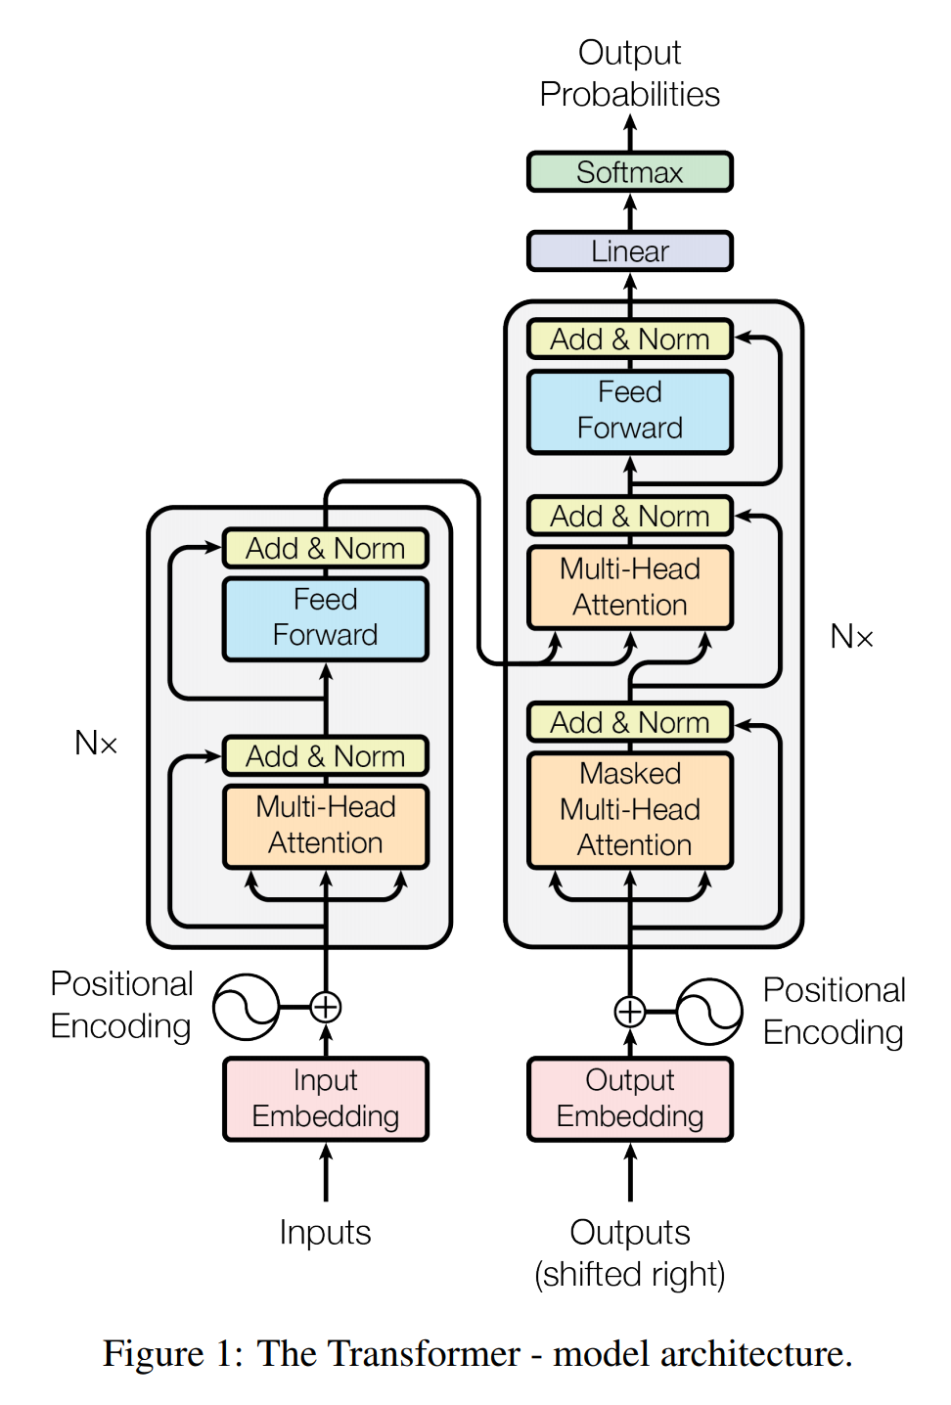
What is a transformer?
A Google Brain model.
Variable-length input
Fixed-length output (but typically extended to a variable-length output)
No recurrence
Surprisingly not patented.
Uses 3 kinds of attention
Encoder self-attention.
Decoder self-attention.
Encoder-decoder multi-head attention.
Notes:
https://arxiv.org/pdf/1706.03762.pdf

Slide 88
The overall architecture

Slide 89
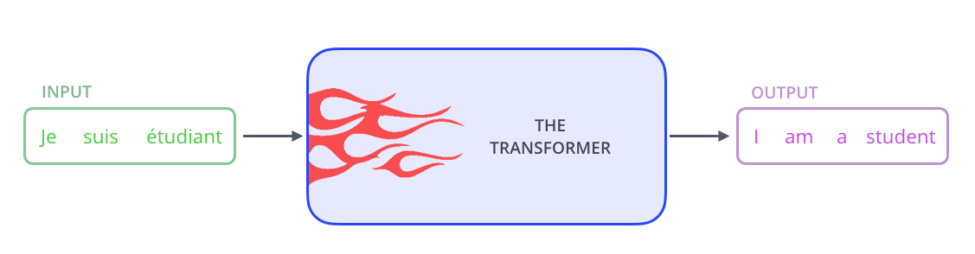
Let’s blow up a transformer bit-by-bit.

Slide 90
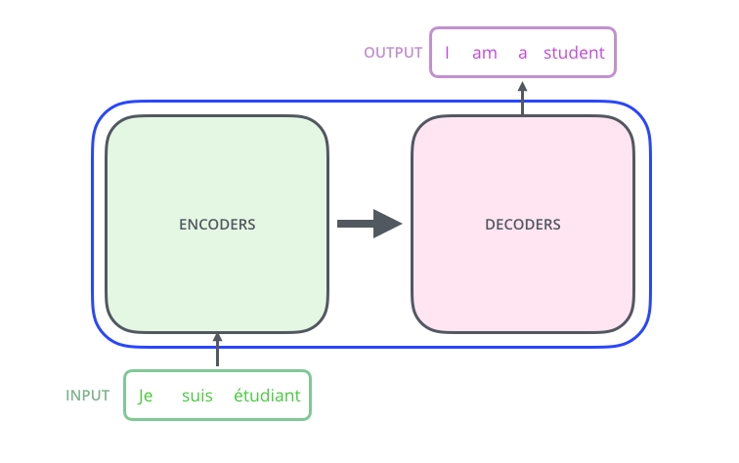
There is an encoder and a decoder.

Slide 91
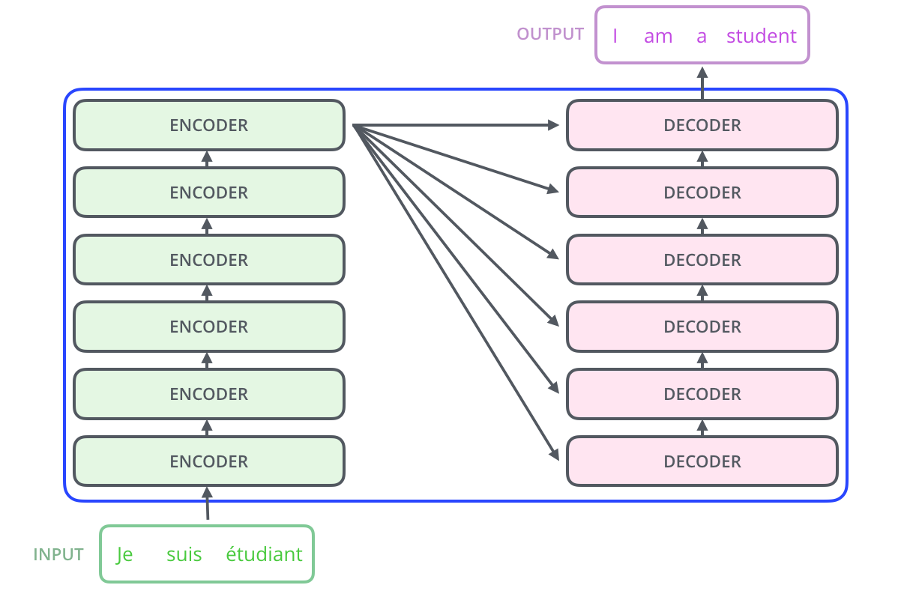
There are several encoder and decoder layers.
Notes:
Constant number, tuned manually

Slide 92
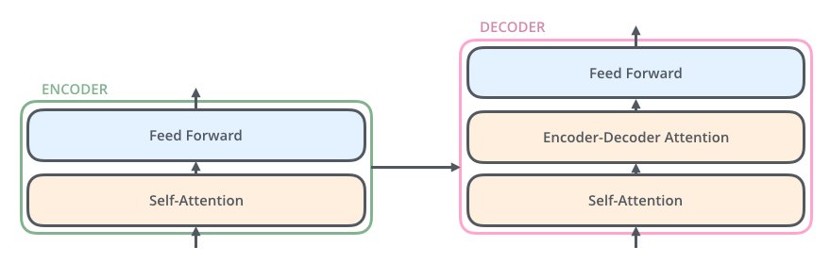
Each encoder / decoder layer has a self-attention layer and a ff.

Slide 93
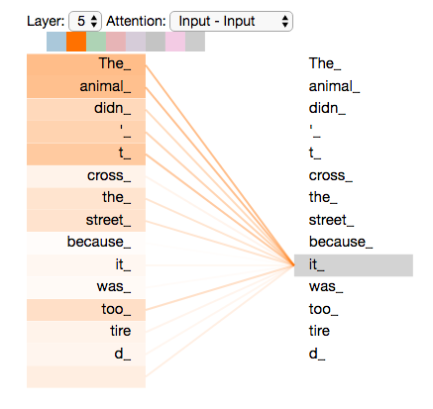
Transformers use the self-attention in the encoder and decoder to learn better context-sensitive representations of the inputs.

Slide 94
Transformers use the self-attention in the encoder and decoder to learn better context-sensitive representations of the inputs.

Slide 95
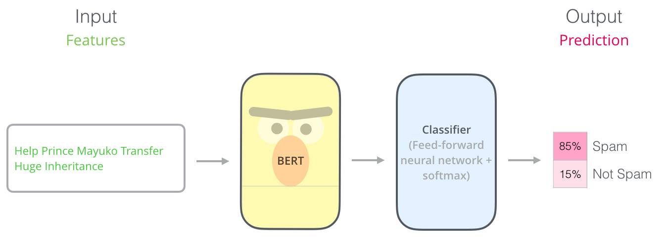
BERT is ImageNet for language
Notes:
https://arxiv.org/abs/1810.04805

Slide 96
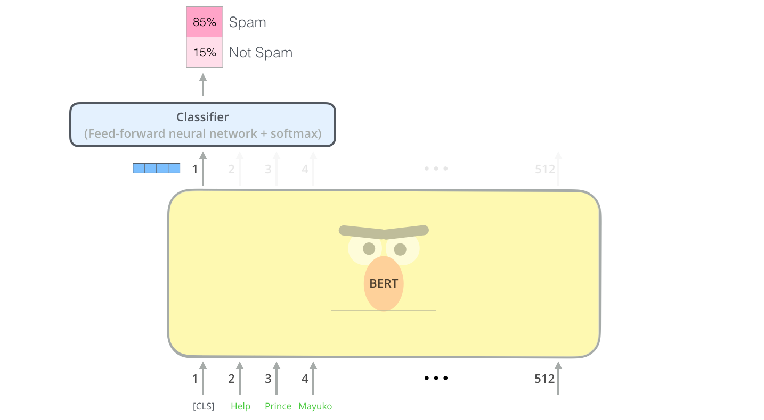
BERT is ImageNet for language
Notes:
https://arxiv.org/abs/1810.04805

Slide 97
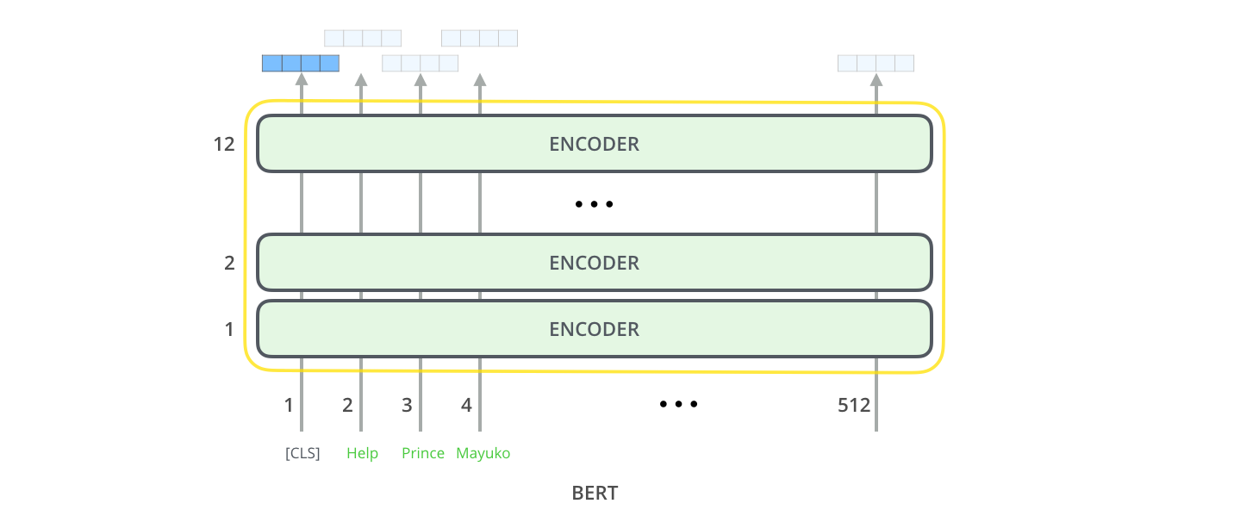
BERT's architecture is just a transformer's encoder stack.
Notes:
https://arxiv.org/abs/1810.04805

Slide 98
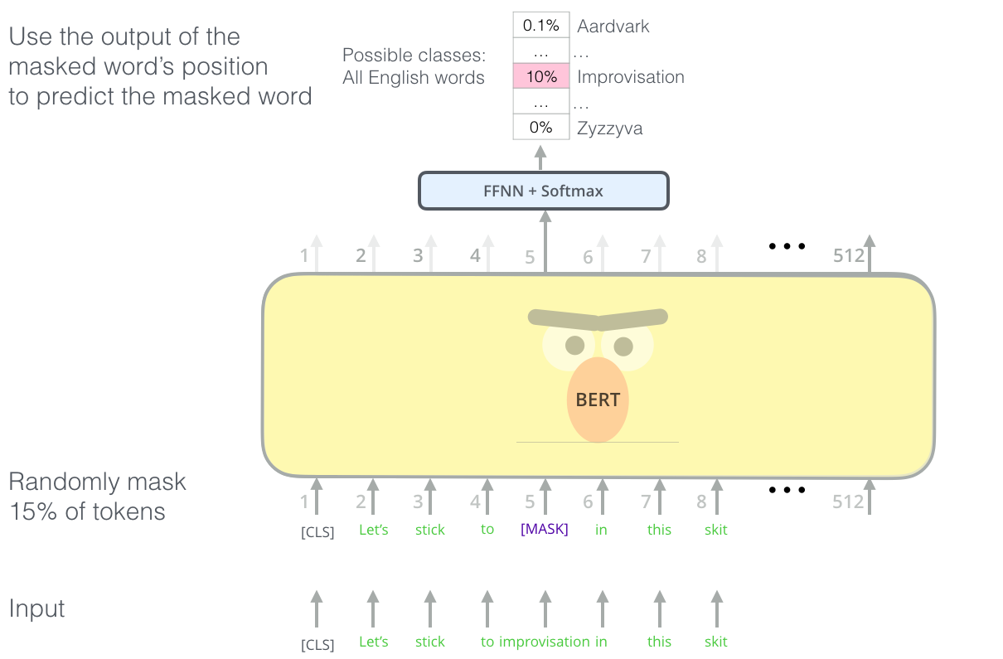
BERT is trained just like a skip-gram model.
Notes:
https://arxiv.org/abs/1810.04805

Slide 100
BERT on SQuAD
Question Answering

Slide 101
OpenAI's transformer
Pre-trained transformer decoder for language modeling

Slide 102
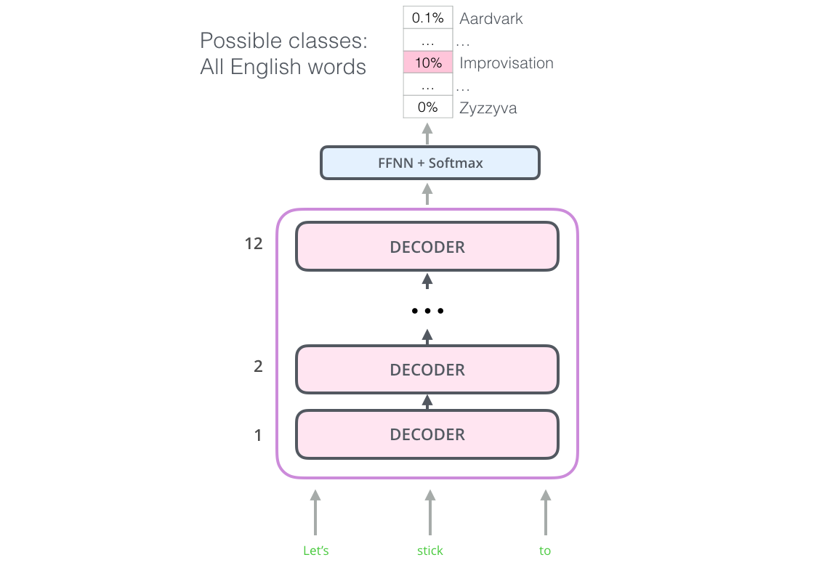
The original OpenAI transformer is just a decoder stack trained on language modeling (unsupervised).

Slide 103

As with BERT, you can use the pretrained model for any task.

Slide 104

Different tasks use the OpenAI transformer in different ways.

Slide 105
“You can’t cram the meaning of a whole %&!$# sentence into a single $&!#* vector!”
-- Ray Mooney, Association for Computational Linguistics (ACL) 2014
Notes:
Ray is somewhat right -- it's very difficult for a seq2seq model to capture everything relevant in a single context vector. So today we're going to talk about transformers which enable BERT… a model that crams the whole meaning of a sentence into a single embedding vector.

